Slide 1
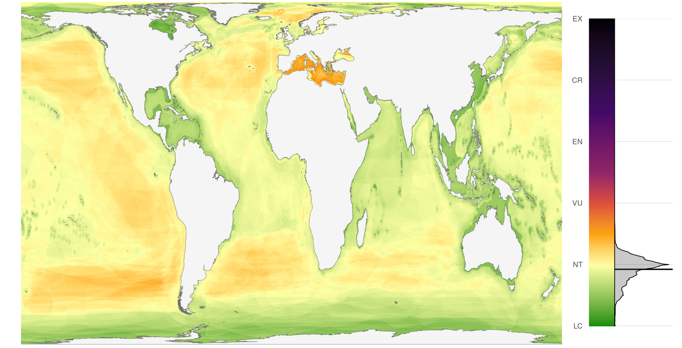
Mapping status and conservation of global at-risk marine biodiversity
Casey C. O’Hara^{1,2}, Juan Carlos Villaseñor-Derbez¹,
Gina M. Ralph³, Benjamin S. Halpern^{1,2}
Bren School of Environmental Science and Management, University of California, Santa Barbara CA 93106
National Center for Ecological Analysis and Synthesis, University of California, 735 State Street Suite 300, Santa Barbara CA 93101
UCN Marine Biodiversity Unit, Department of Biological Sciences, Old Dominion University, Norfolk, VA 23529, USA

Slide 2
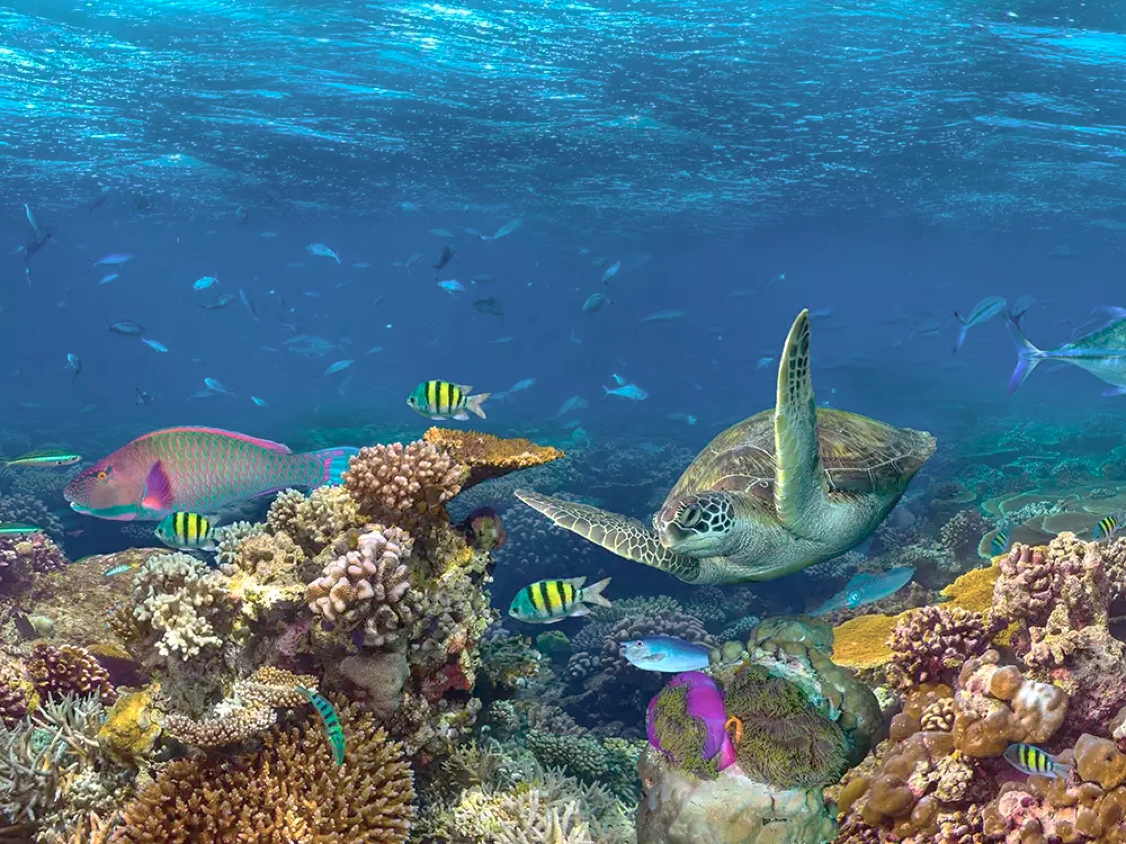
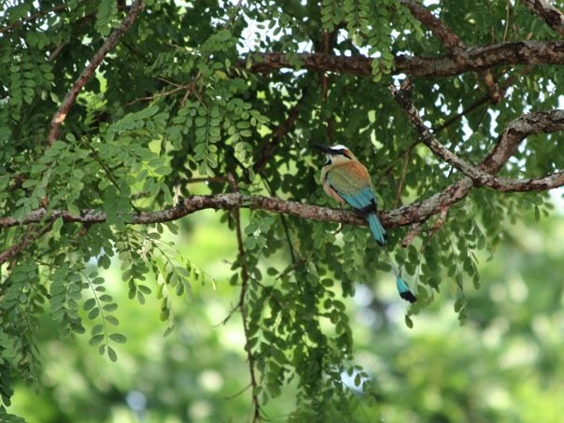
Biodiversity is a measure of the rich variety of life on Earth or in a particular habitat or ecosystem.
stockphoto-graf
Conservation of biodiversity is a “common concern of humankind.”
- Convention on Biological Diversity, 1992
Notes:
There is a broad recognition of the importance of marine biodiversity in terms of benefits we enjoy from increased food provision and greater resilience in the face of impacts and disturbances. The Convention on Biological Diversity states that biodiversity conservation is a “common concern of humankind” – to ensure that we can continue to enjoy the benefits of a healthy ocean into the future.
Setting conservation priorities requires understanding the current status of biodiverse ecosystems. We may want to protect a heavily impacted area to allow the ecosystem recover to a healthy state; on the other hand, we may want to protect a pristine area to maintain its healthy condition.
But common global measures of marine biodiversity provide little information about the status of those species or ecosystems. So we’ve developed a new map to better inform conservation decision making.

Slide 3
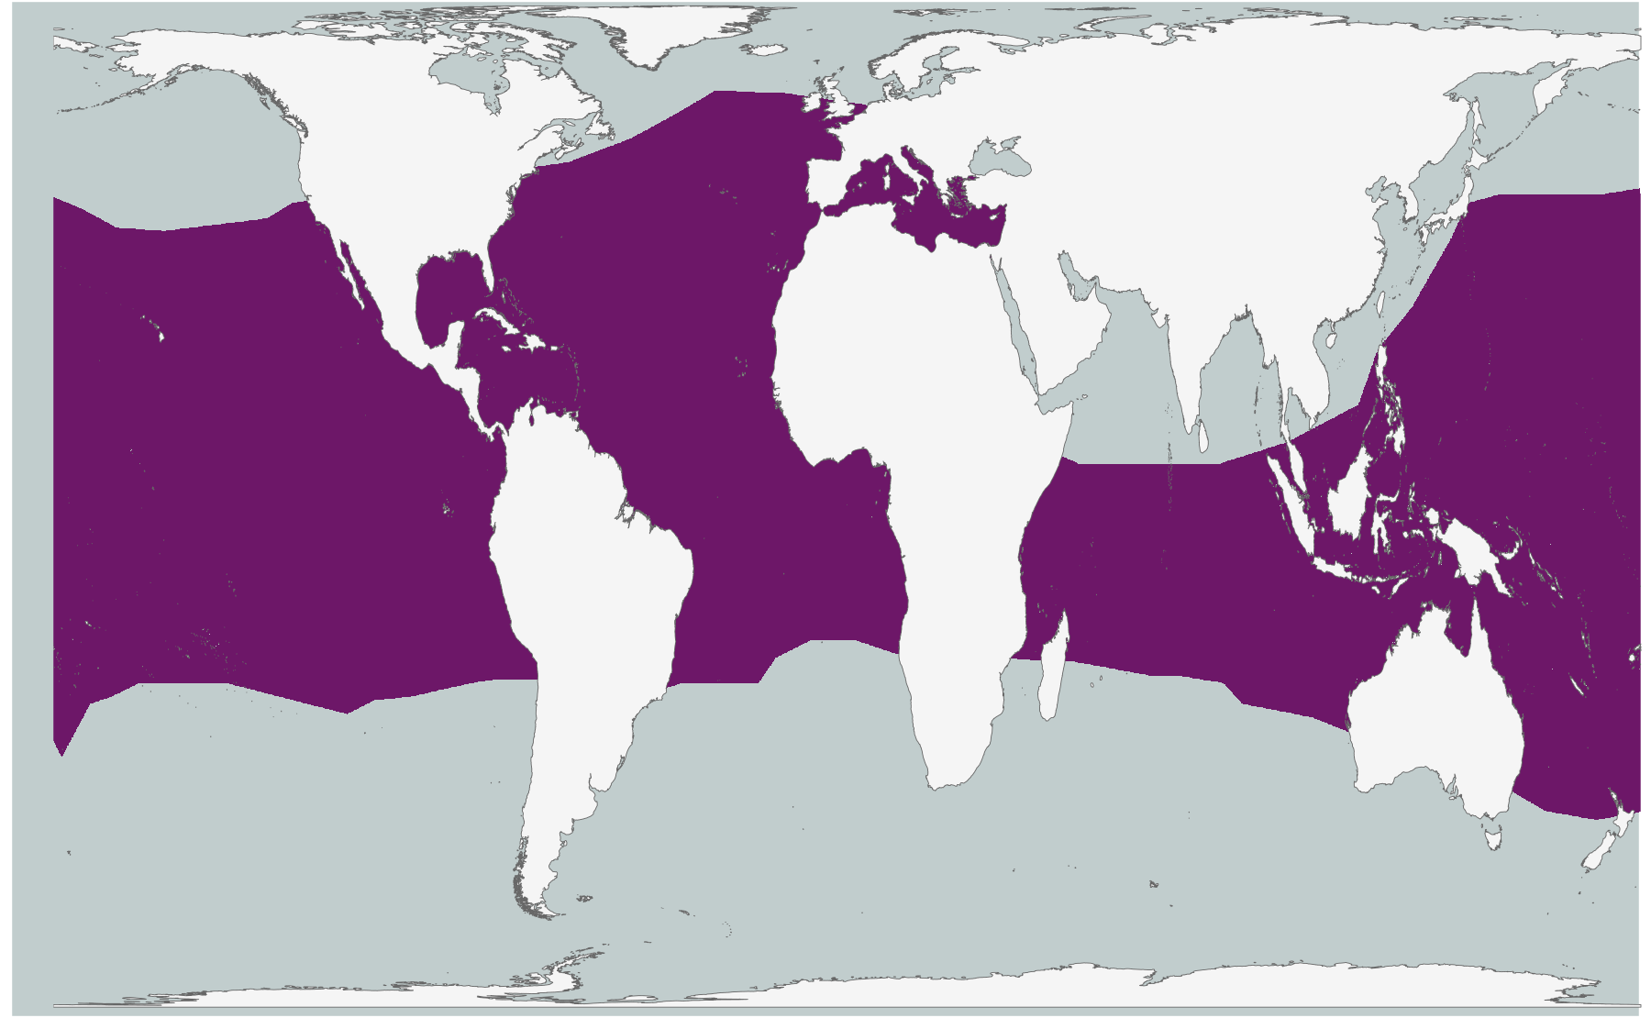
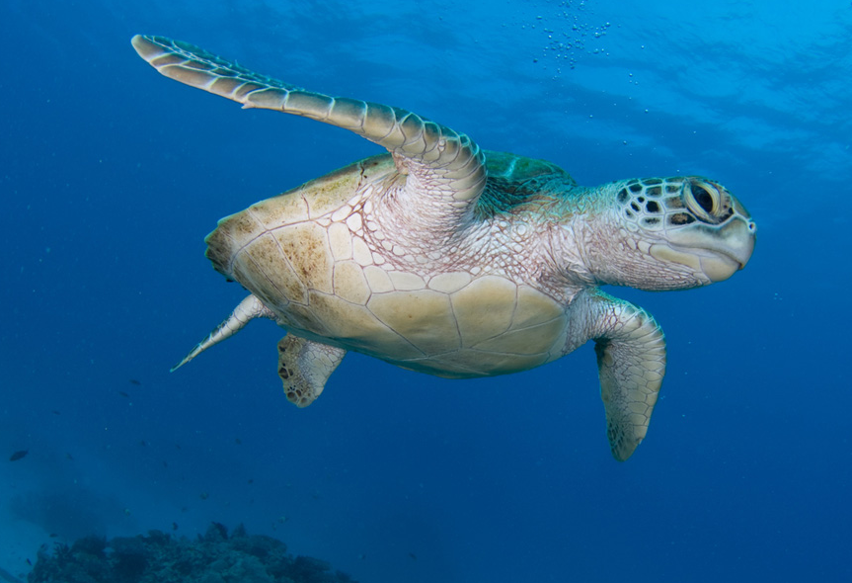
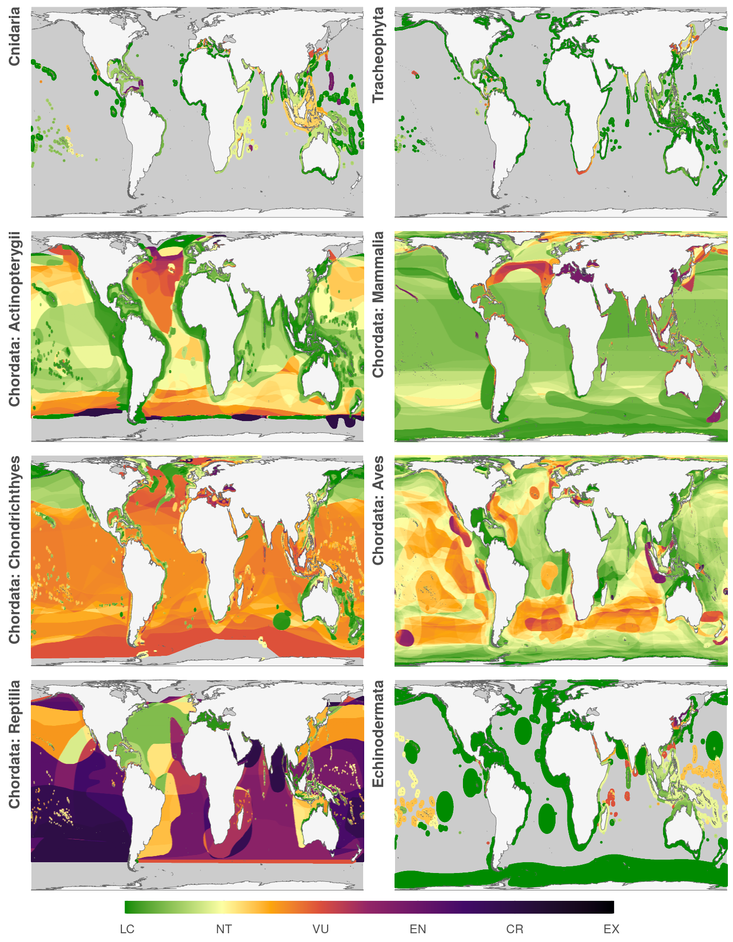
Species ranges and extinction risk
© Xanthe Rivett
Notes:
What my colleagues and I have done is to take range maps, like this one, for nearly 5300 marine species, in combination with their IUCN Red List extinction risk, from least concern to extinct.
This example shows the global range of the green turtle, and I’ve color coded it <HIT BUTTON> to show that the global population is considered “endangered.”

Slide 4
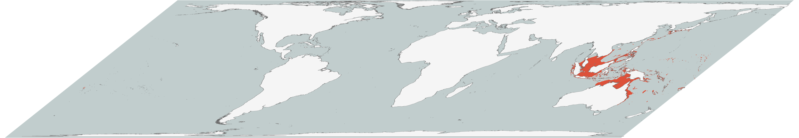
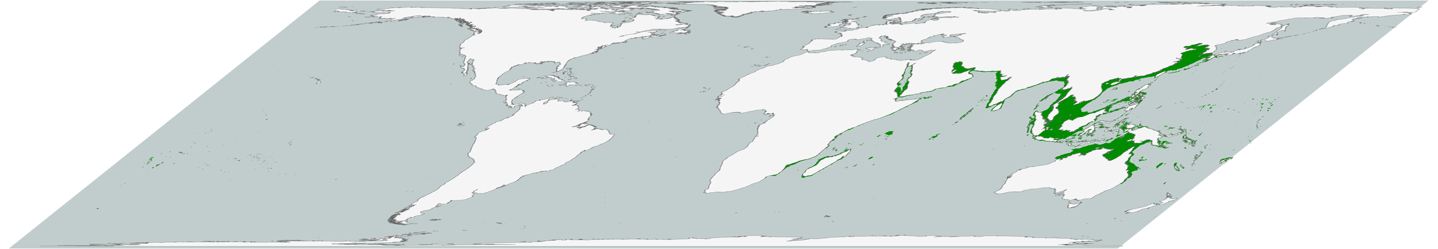
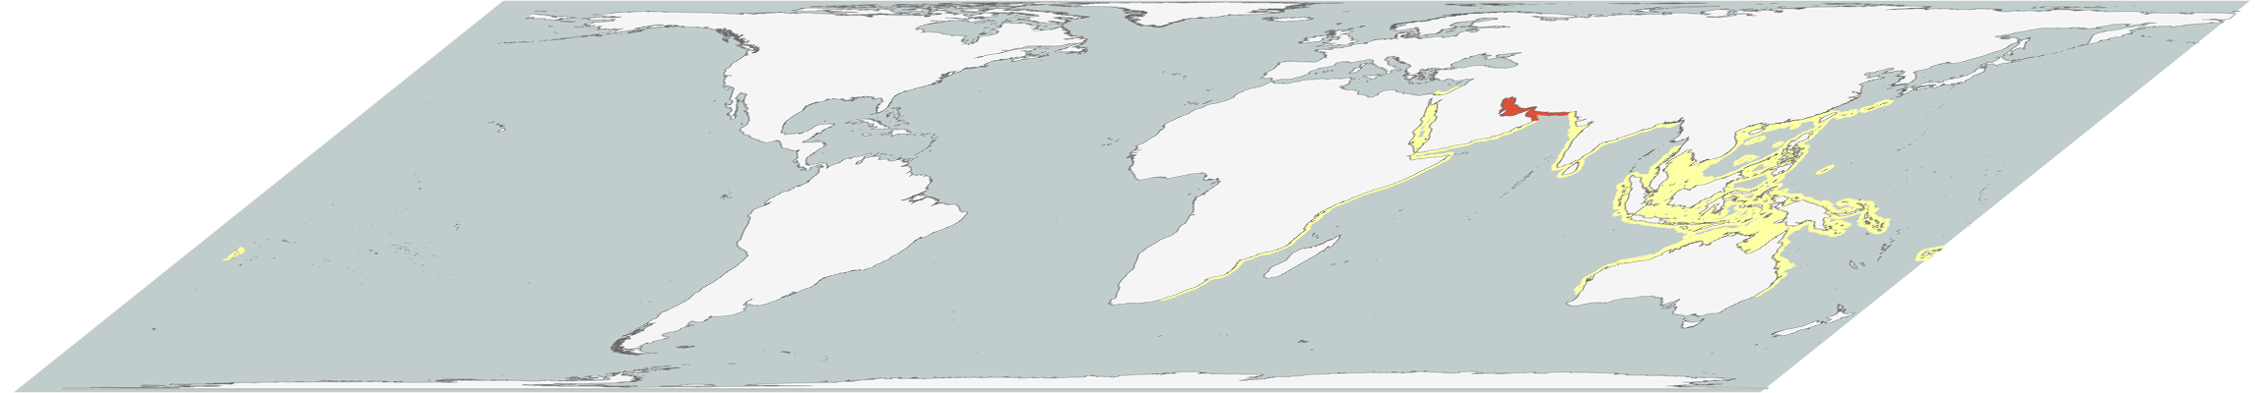
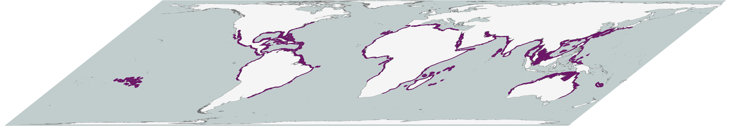
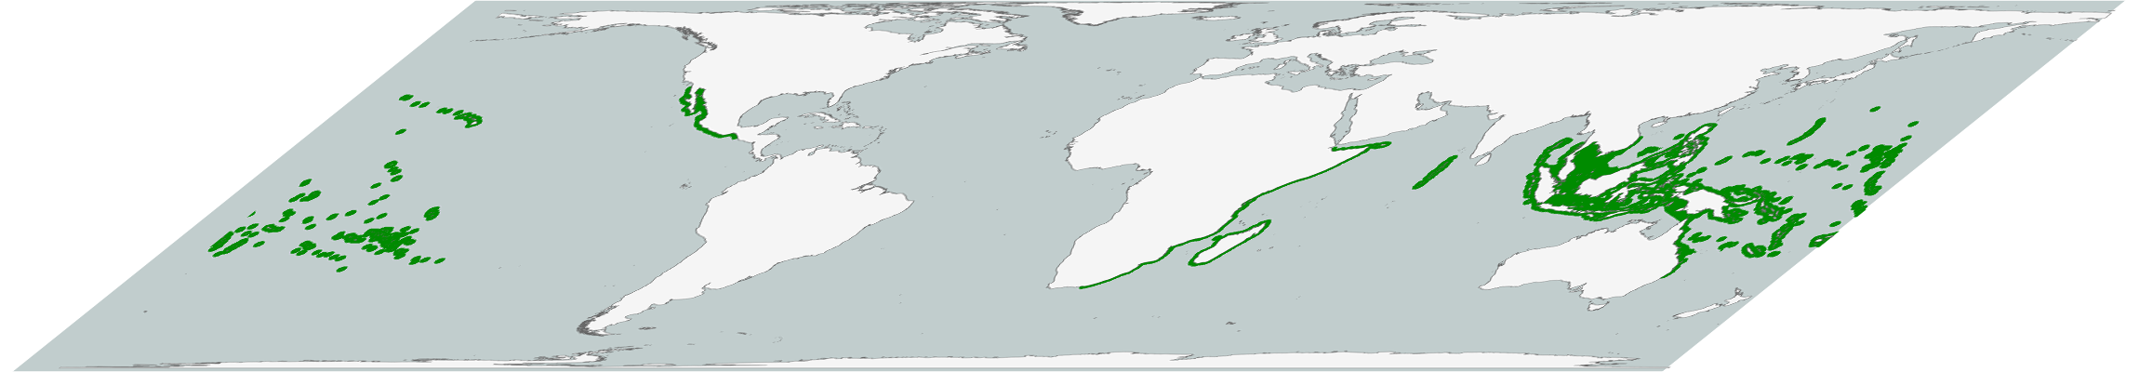
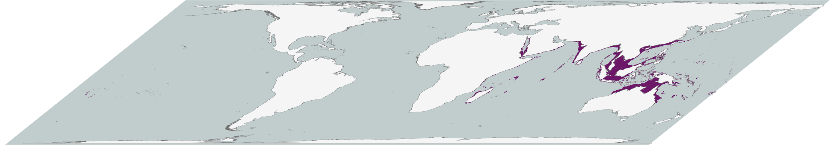
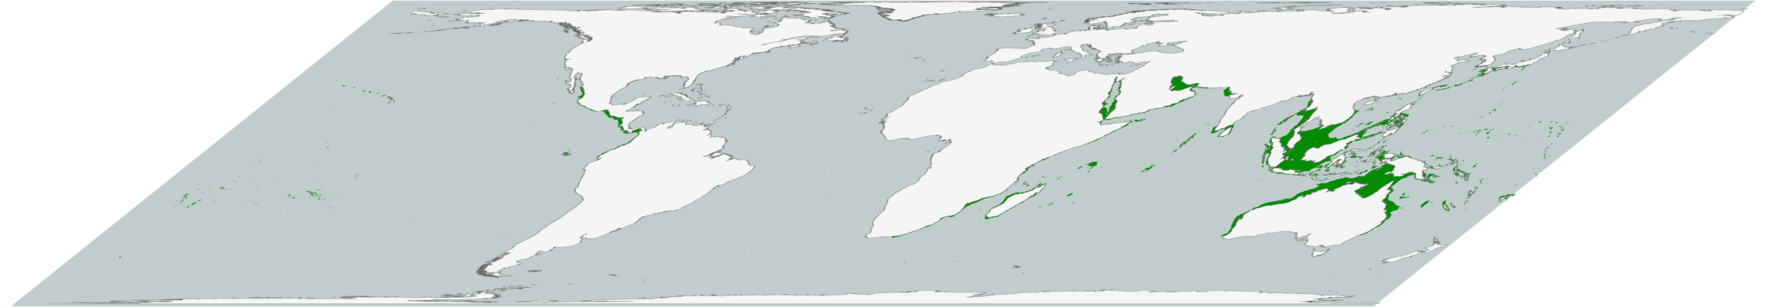
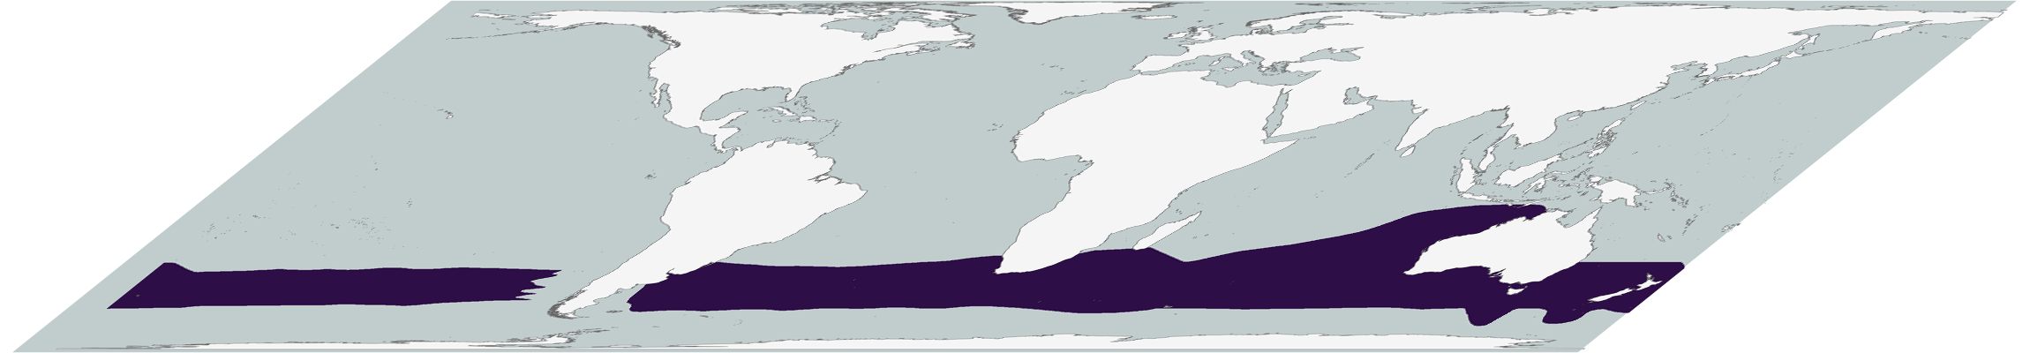
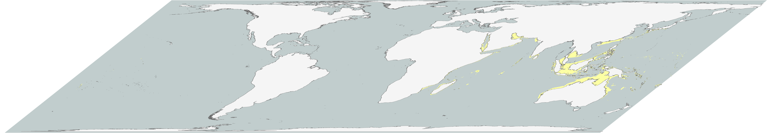


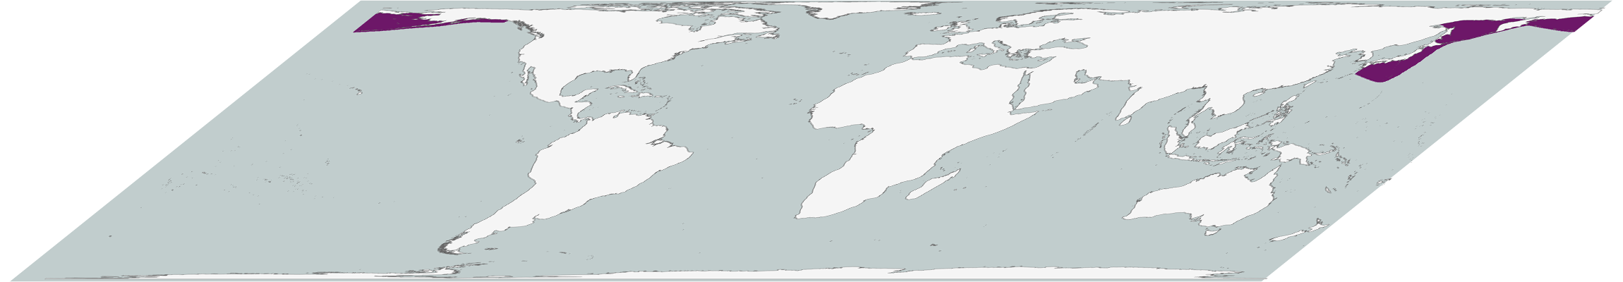
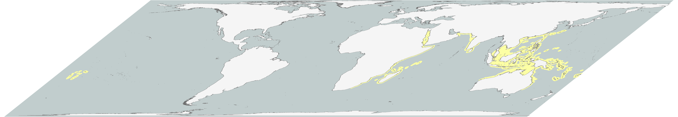
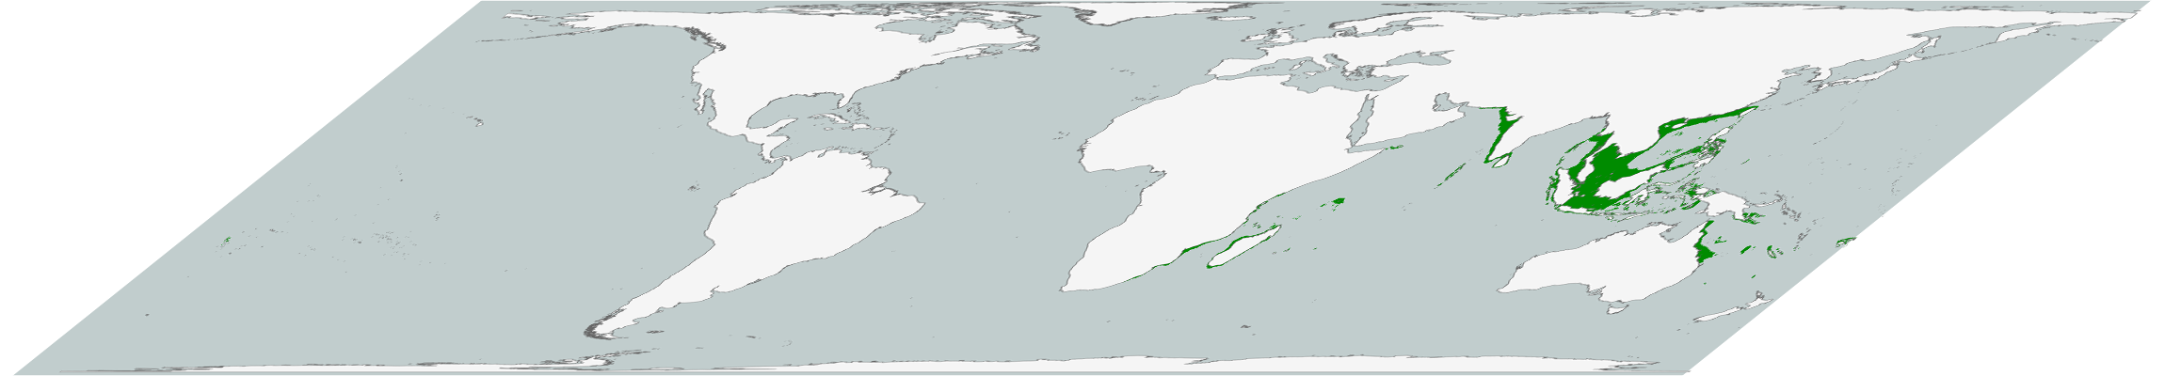
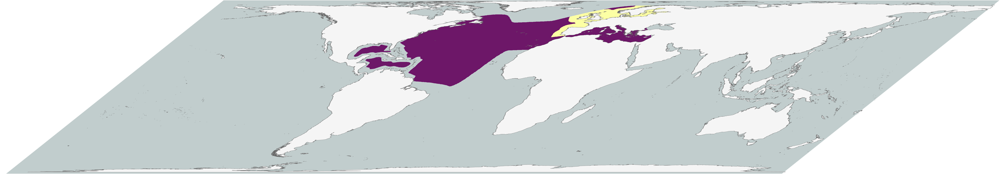
Combine data for 5,291 species
Notes:
Stacking all 5300 species range maps and finding the average status of all species in each pixel,
ADVANCE SLIDE

Slide 5
Calculate mean risk for each pixel
Notes:
we create a map showing the distribution of at-risk marine biodiversity around the globe.

Slide 6
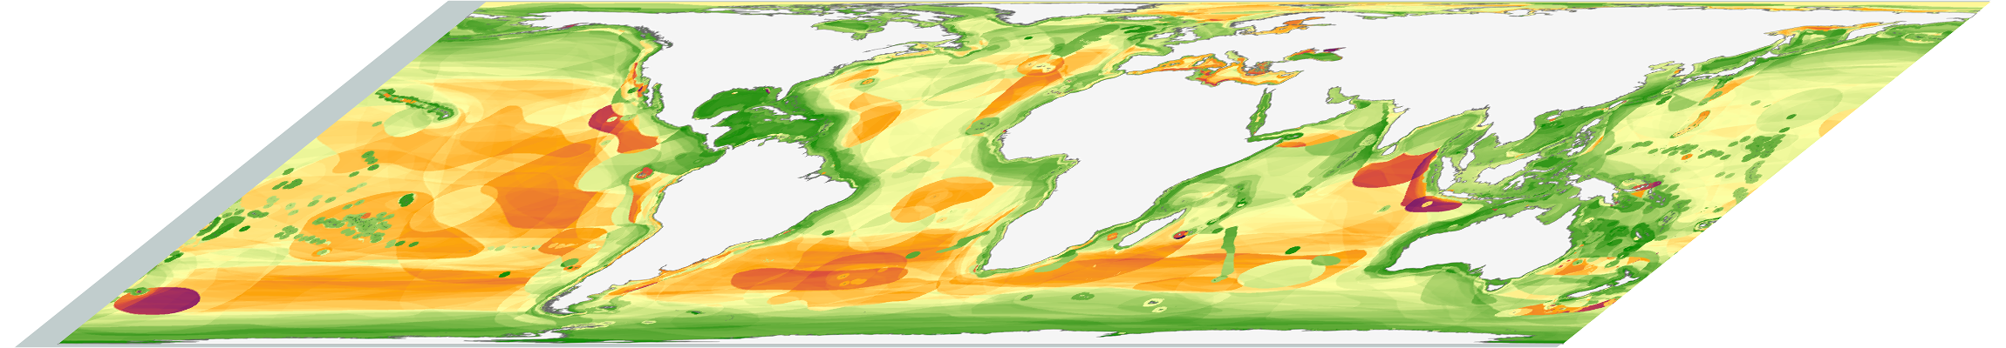
… resulting in a global map of marine biodiversity risk
Calculate mean risk for each pixel
Notes:
we create a map showing the distribution of at-risk marine biodiversity around the globe.

Slide 7
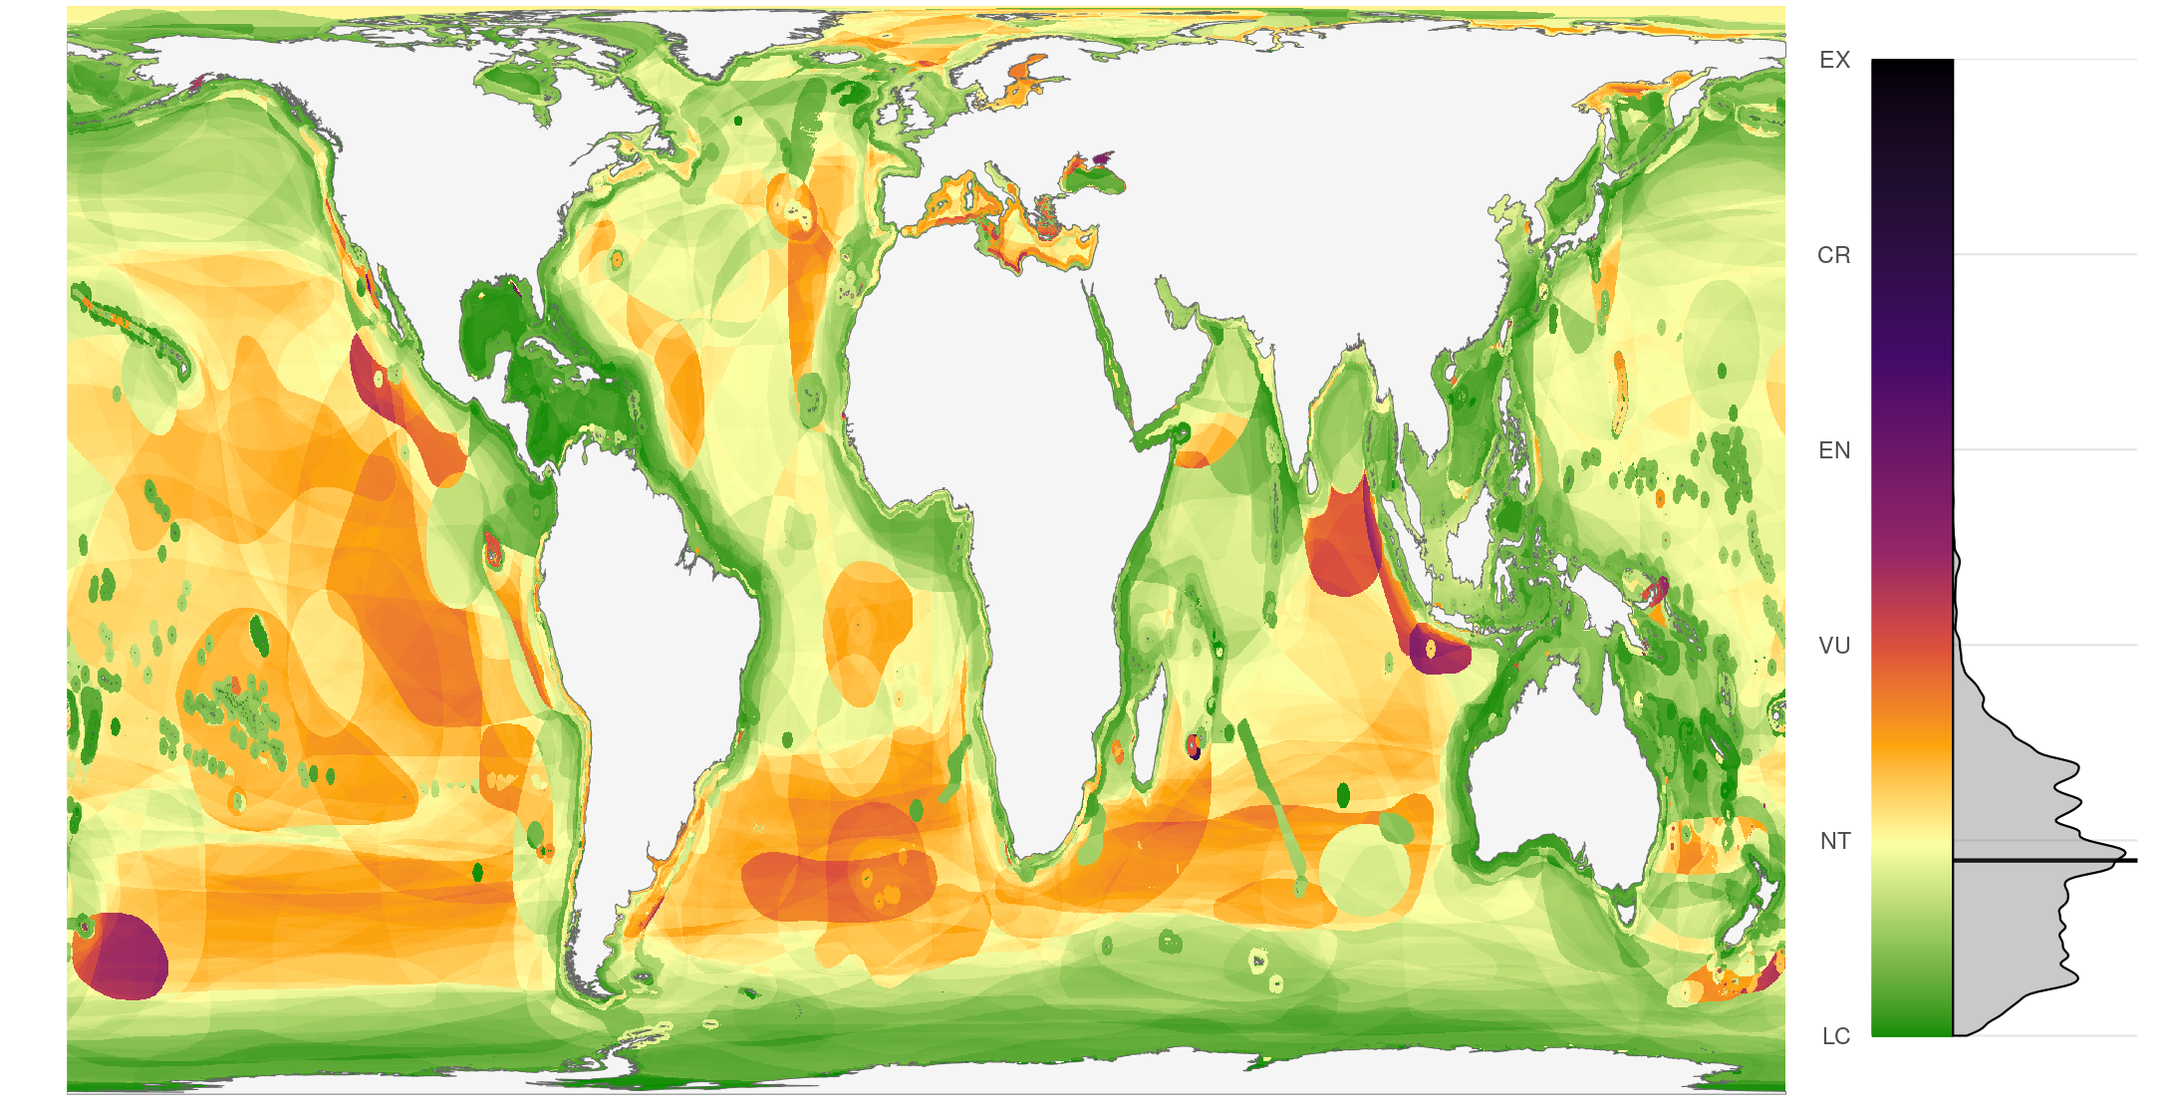
At-risk global marine biodiversity
Notes:
This sidebar shows how much of the global oceans fall into different risk levels; the global mean is at about “near threatened”.
A few patterns stand out:
* coastal waters are often generally at lower risk than the open ocean;
* certain locations show higher risk due to increased pressure from human activities;
* a few places show very high risk due to the presence of critically endangered species found nowhere else.

Slide 8
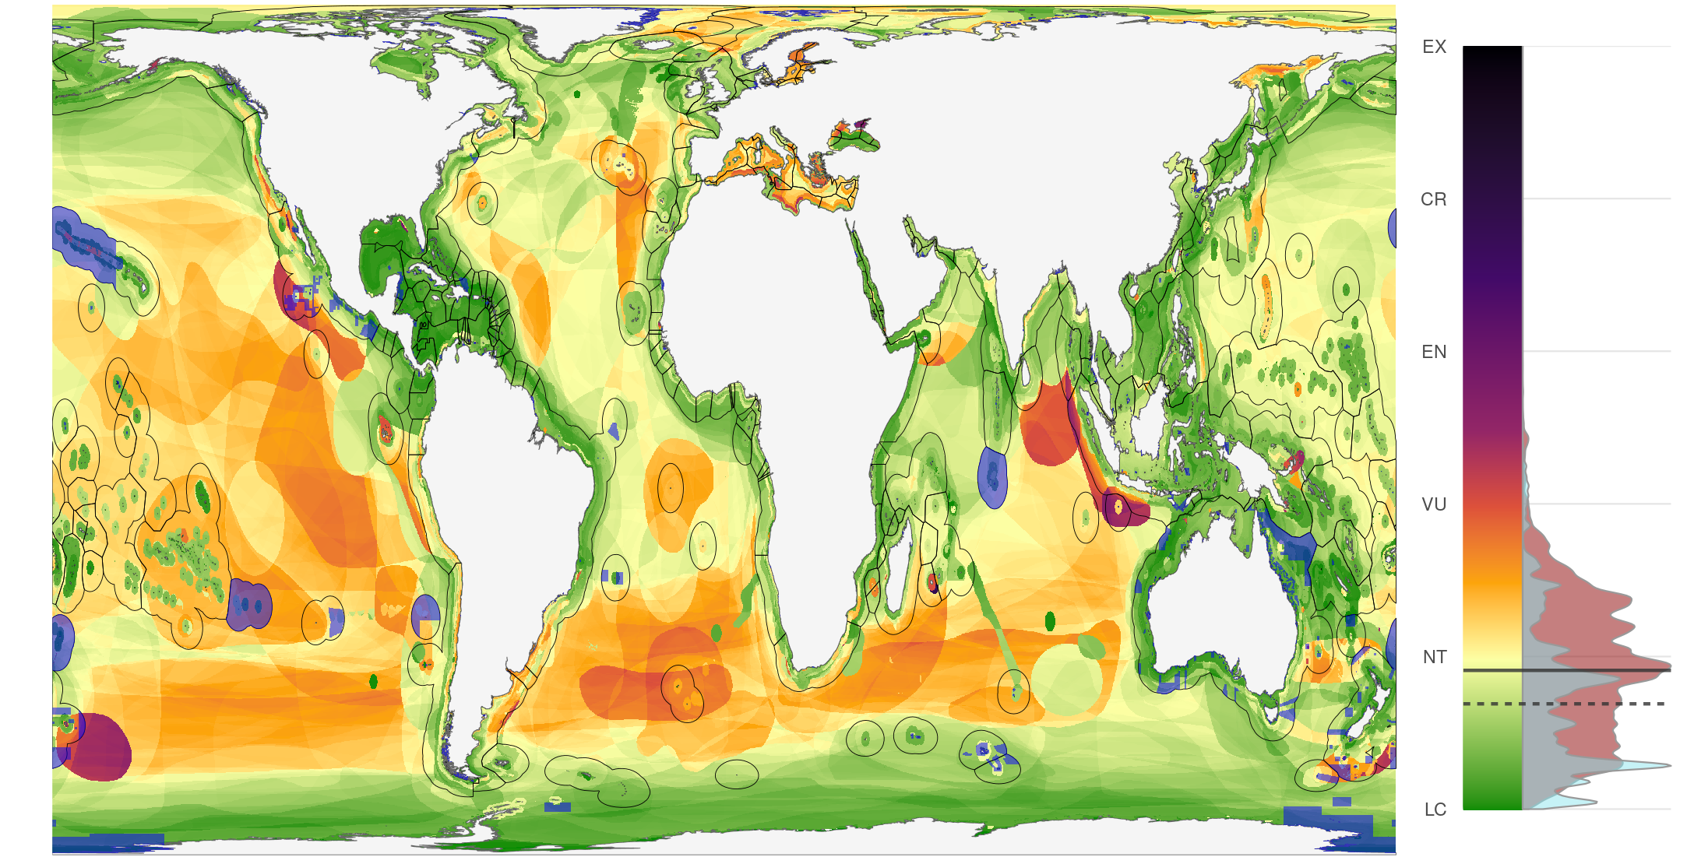
Global marine reserve protection
Notes:
These blue areas show marine reserves under full or strong protection that prohibits fishing and other extractive uses; the sidebar now differentiates between protected biodiversity, in blue, and unprotected biodiversity, in red.
Note that biodiversity under protection is at about 5% lower risk than unprotected biodiversity. Don’t take this as a sign that marine reserves are awesome, though they are. Instead consider that highly impacted areas are generally where people are exploiting the oceans for food and livelihoods - so closing off highly impacted ocean is politically and financially more costly than protecting a healthy but remote bit of ocean where no one is going to complain. Effective conservation will require a balanced approach between proactive and reactive protection of marine biodiversity.
This global map of at-risk marine biodiversity can help identify opportunities and needs for future marine conservation efforts. Next steps will be to compare these general risk patterns with patterns of specific human impacts, for instance fishing effort, which can be mitigated through conservation policy, and climate change impacts which may require more adaptive conservation strategies.

Slide 9


Mapping status and conservation of global at-risk marine biodiversity
Casey C. O’Hara^{1,2}, Juan Carlos Villaseñor-Derbez¹,
Gina M. Ralph³, Benjamin S. Halpern^{1,2}
Bren School of Environmental Science and Management, University of California, Santa Barbara CA 93106
National Center for Ecological Analysis and Synthesis, University of California, 735 State Street Suite 300, Santa Barbara CA 93101
UCN Marine Biodiversity Unit, Department of Biological Sciences, Old Dominion University, Norfolk, VA 23529, USA
Notes:
Additional maps and detailed analysis can be found in our manuscript which is currently under review at Conservation Letters.
Thank you.

Slide 10
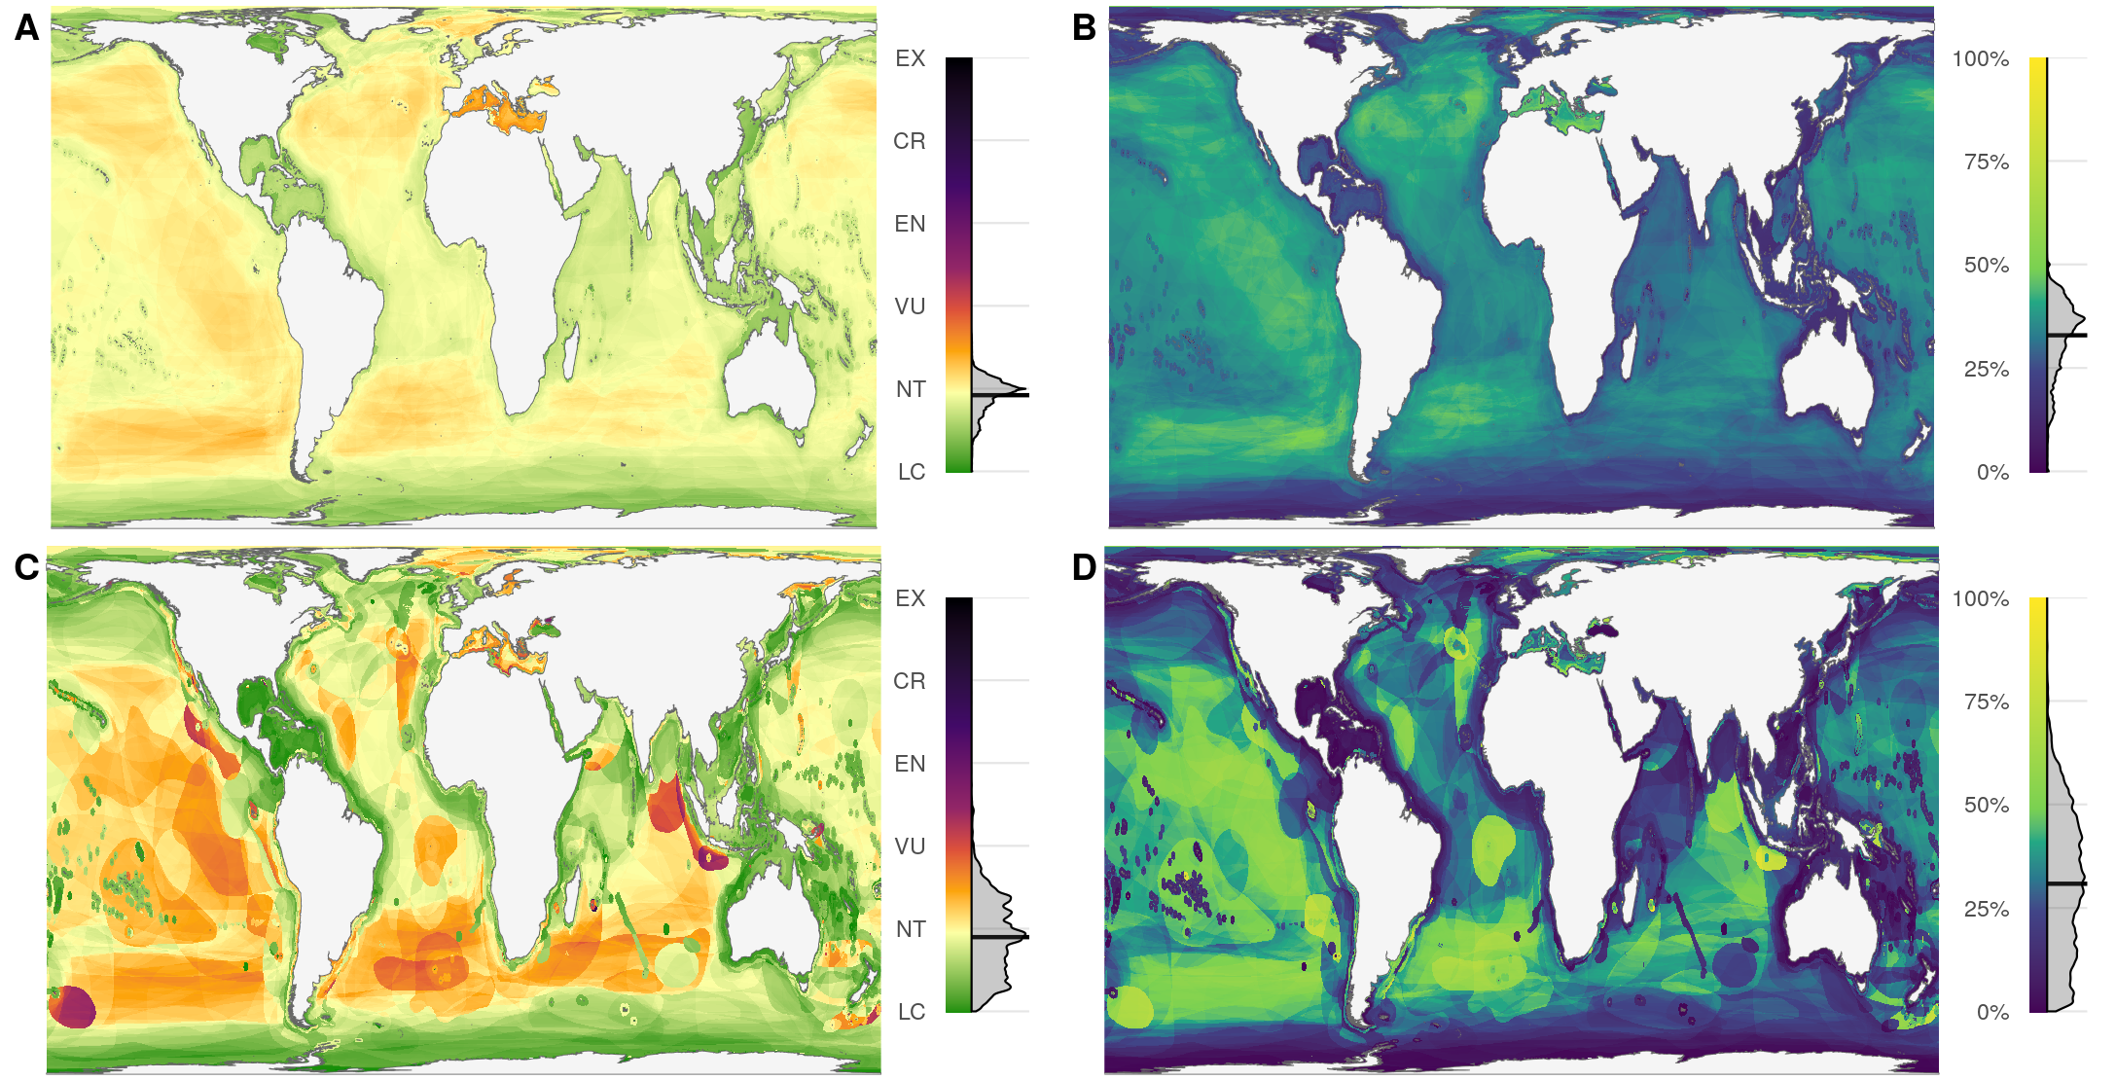
Risk and Percent Threatened

Slide 11
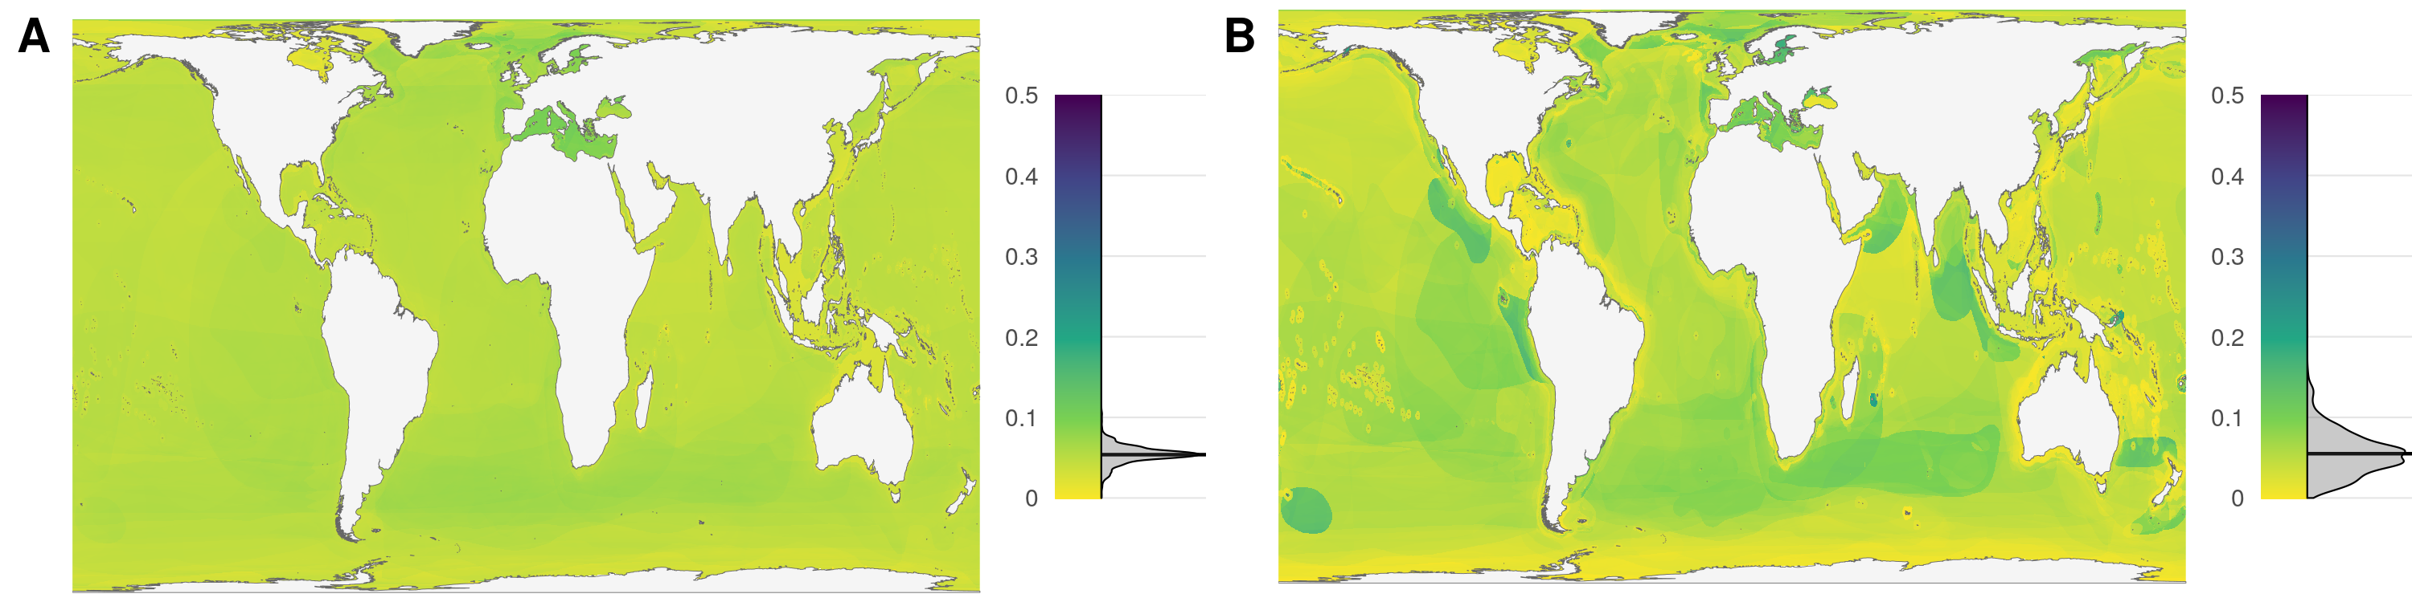
Variance of risk

Slide 12
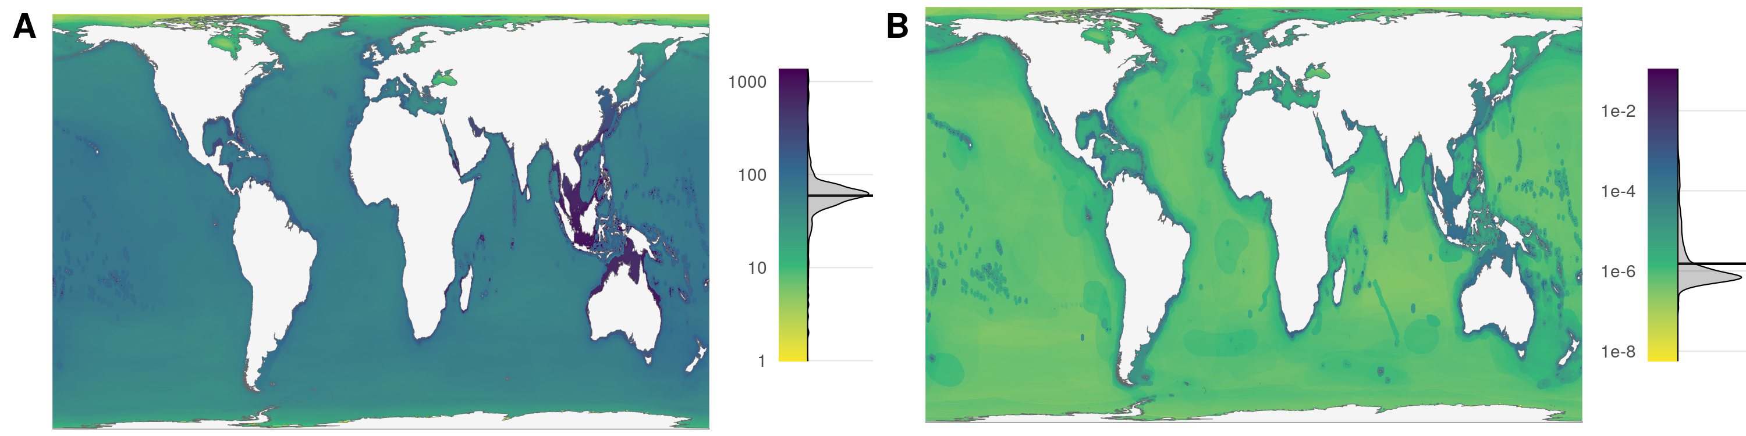
Species richness

Slide 13
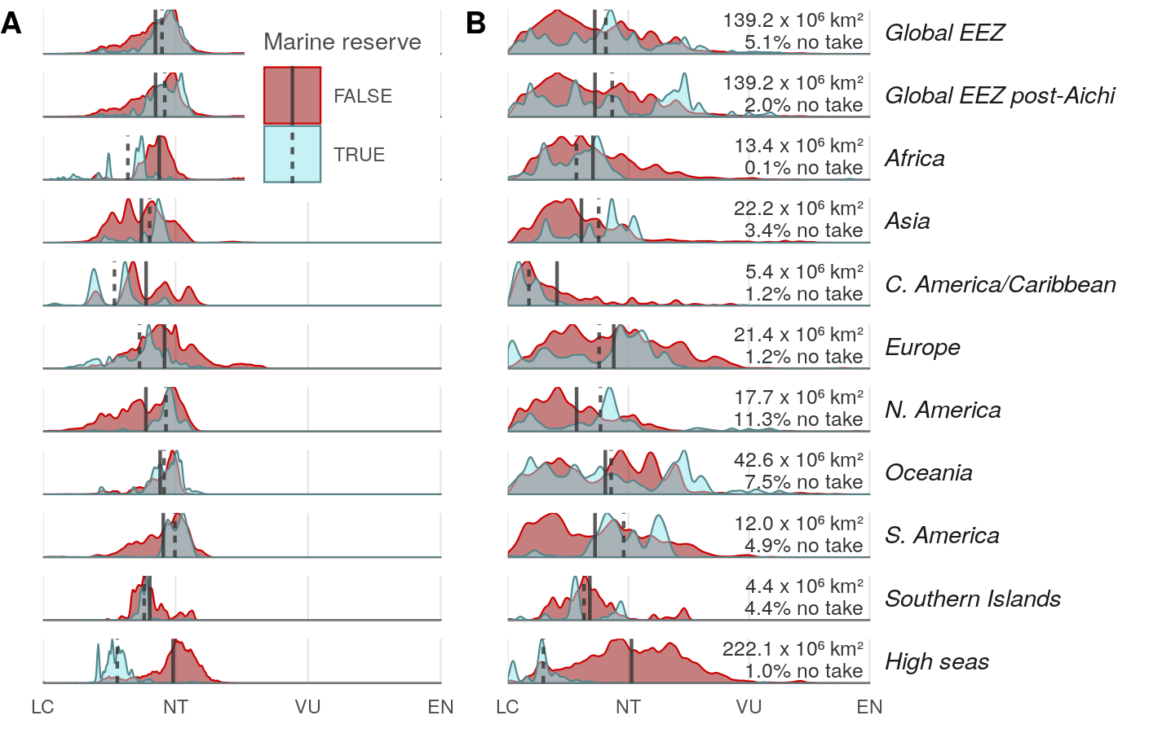
Marine reserve protection by georegion

Slide 14
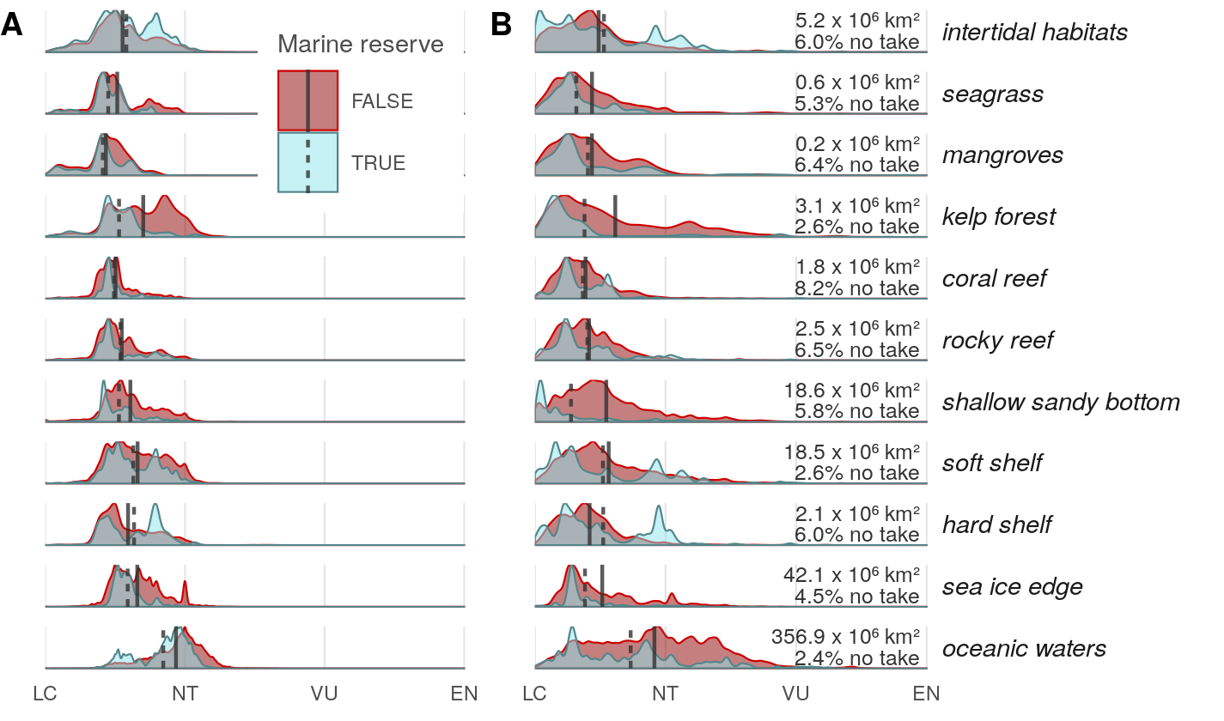
Marine reserve protection by habitat

Slide 15
Taxonomic groups

